Slide 1

Twitter Sentiment Analysis
Bradley Payne & Nithya Alavala

Slide 2
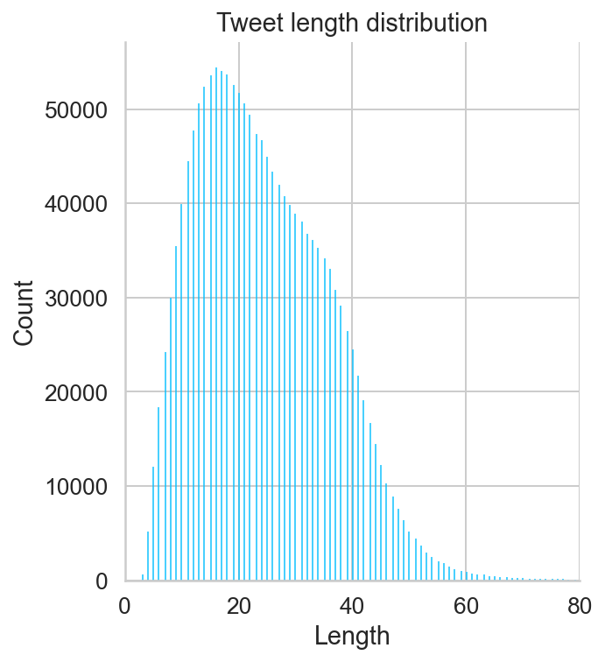
Data Collection and Exploration
We used a pre-labeled dataset available on Kaggle.com named “Sentiment140 dataset with 1.6Million tweets”
1.6 million tweets total
Dataset contains 800,000 Negative tweets
800,000 Positive tweets
Length ranges from very small (1) to nearly 75 words

Slide 3

Dataset
target: the polarity of the tweet (0 = negative, 4 = positive)
ids: The id of the tweet
date: the date of the tweet
April - May 2009
flag: The query
All columns had a value of NO_QUERY
user: the user that tweeted
text: the text of the tweet

Slide 4
Data Preprocessing
Text Cleaning
Remove punctuation
Remove retweet symbols
Removed urls
Converted to lowercase
Removed stopwords
Text Representation Methods
Bag-of-Words using the sklearn CountVectorizer preprocessor
This converts each text into a sparse, one-hot encoded matrix
Tokenization
Encode each word as a token, then transform each text into a list of tokens
Stemming
Reduces a word to its word stem
Can sometimes remove important information
I.e. studies -> studi
Lemmatization
Attempts to find the simplified ‘root’ word or meaning
Allows a morphological change to help keep the words’ meaning
I.e. studies -> study
Used nltk package to complete this task

Slide 5
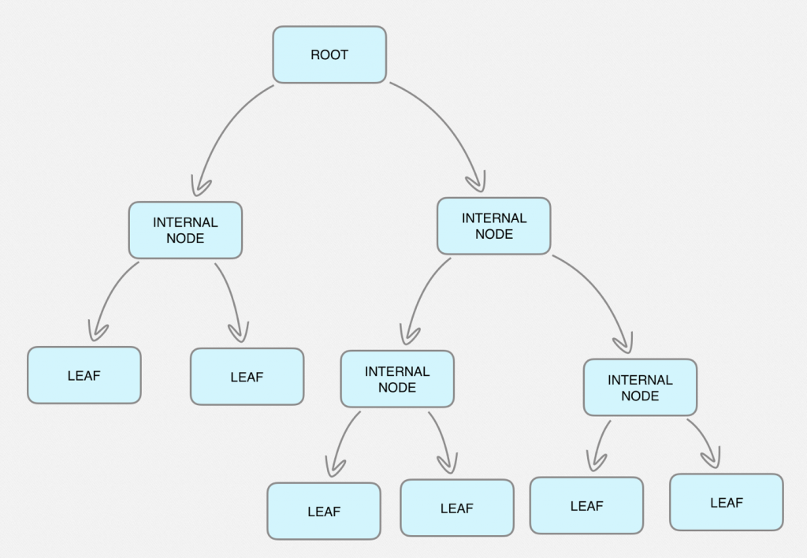
Methods (baseline)
We tried a variety of Machine Learning models
Naive Bayes
Decision Tree
SVM
Random Forest
Used a cross validation grid search to find the best hyperparameters
Some of the methods’ grid search was not able to complete due to long fit times.

Slide 6
Methods (More Advanced)
BERT - State of the art method
LSTM
LSTM with GloVe Word Embedding
LSTM with attention Layer
70% Training/Validation, 30% Testing for all models

Slide 7
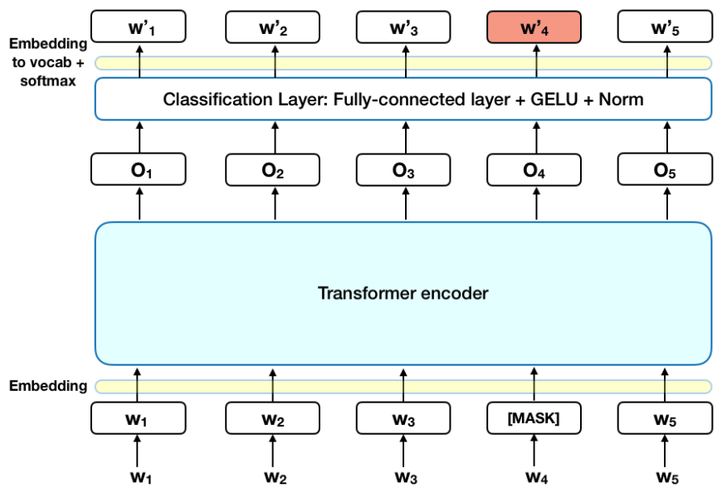
Modeling Bert
BERT (Bidirectional Encoder Representations from Transformers)
Works by using an attention mechanism to learn contextual relationships between words
We used the pretrained version from the HuggingFace and Pytorch library
Fine tuned with 2 epochs on our training data

Slide 8
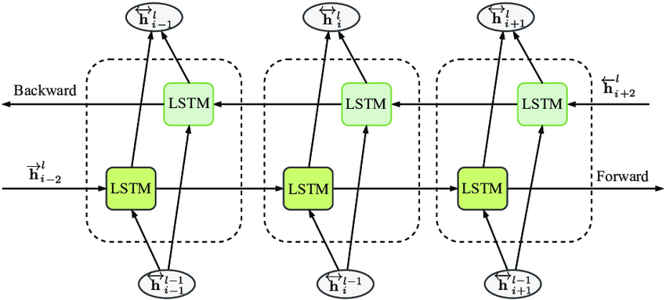
Methods
Bi - LSTM
Processes the data both in backward and forward directions
Trained this model on raw data and pre-processed data
Trained 25 Epochs, with Adam optimizer
Notes:
Bradley

Slide 9
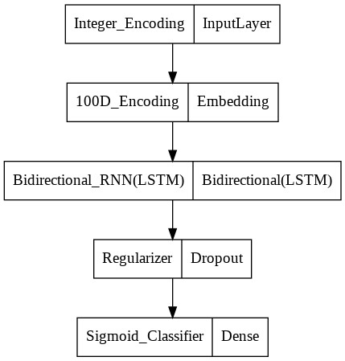
Modeling cont.
Bidirectional LSTM on raw data.
Data - > Tokenize - > Vectorize - > Pad

Slide 10
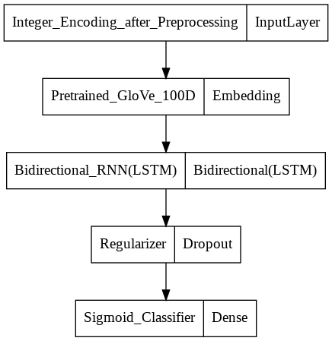
Modeling cont.
Bidirectional LSTM with pre-trained word embedding layer on pre-processed data
Data - > Tokenize - > Remove stopwords - > Part-of-speech(POS) - > Lemmatize -> Clean - > Vectorize -> Pad

Slide 11
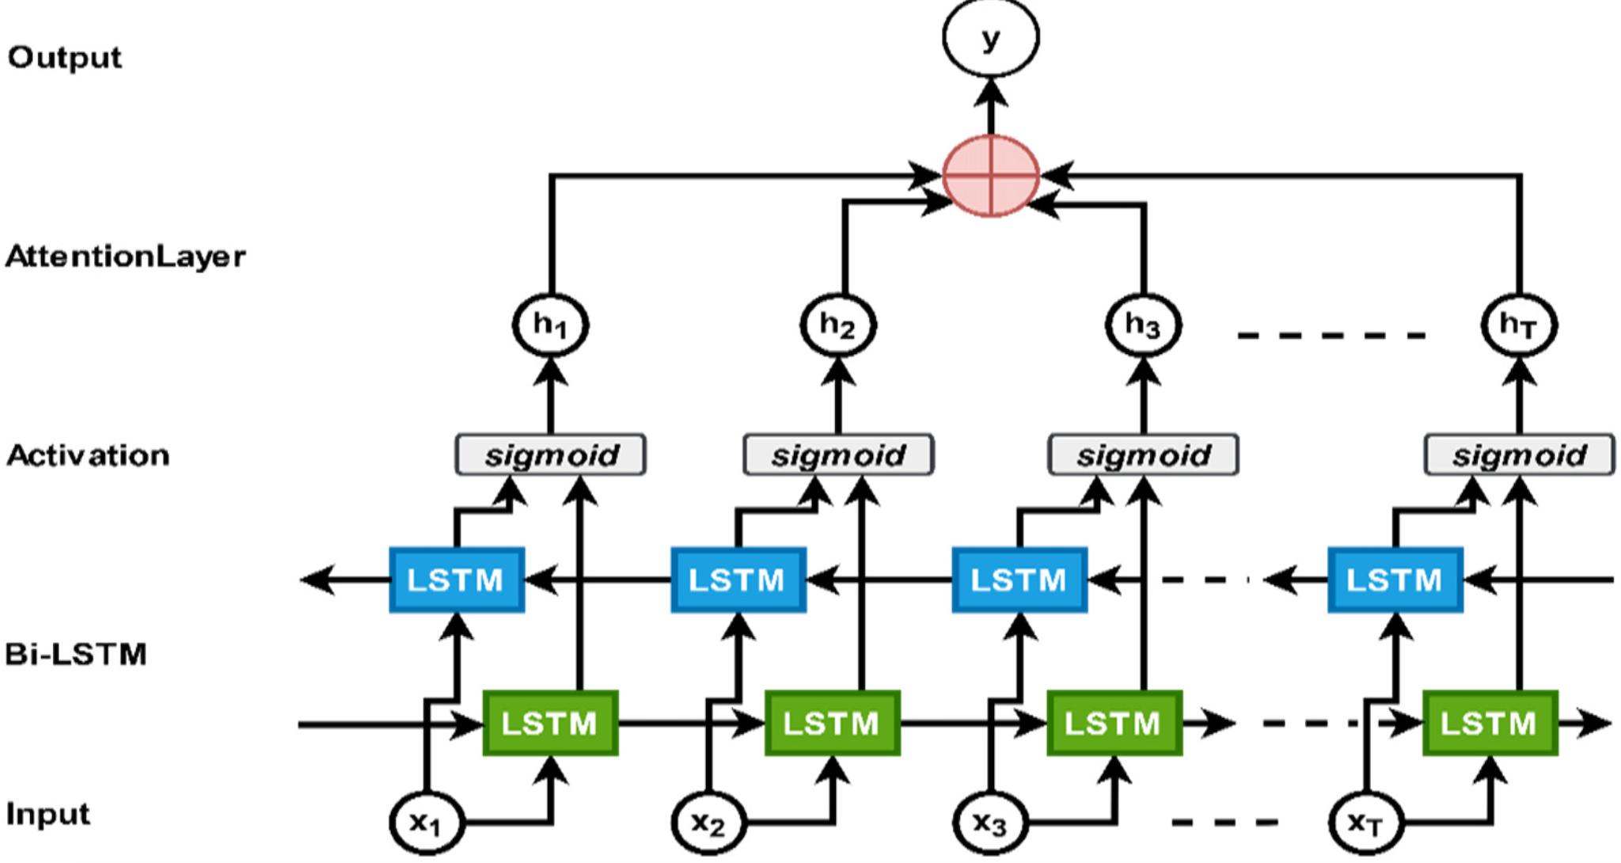
Modeling cont.
Attention Layer LSTM
To make the model more accurate,
we have introduced an attention layer
to the model to evaluate and
compare the accuracy of both the approaches.

Slide 12
Results
Method | Train Accuracy | Test Accuracy
SVM | 0.555 | -
Naive Bayes | 0.5153 | 0.5142
Decision Tree | 0.9903 | 0.6544
Random Forest | 0.9888 | 0.7708
Notes:
Nithya

Slide 13
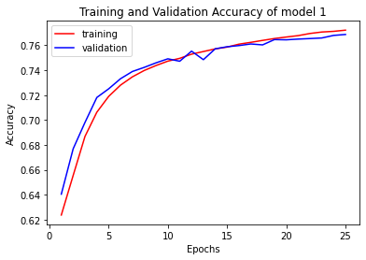
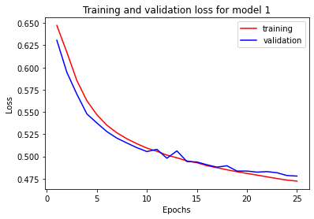
Results cont.
Bi-LSTM on unprocessed data.
Notes:
Nithya

Slide 14
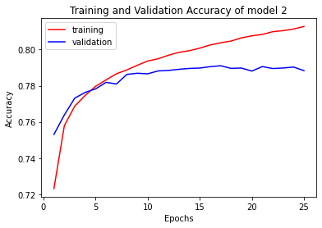
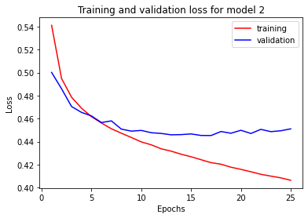
Results cont.
Bi-LSTM on pre-processed data.
Notes:
Nithya

Slide 15
Results cont.
Method | Train Accuracy | Validation Accuracy | Test Accuracy
Bi-LSTM, Raw Data | 0.772 | 0.7687 | 0.7677
Bi-LSTM, Preprocessed Data | 0.8128 | 0.7883 | 0.7879
Bi-LSTM, with attention layer | 0.7837 | 0.7765
BERT | 0.8802 | 0.8688 | 0.8698

Slide 16
Conclusions
We were able to fit several classical machine learning models on the text to obtain a baseline score
The LSTM models were able to achieve better performance and beat the baselines
Adding word-embedding and layer attention further increases classification performance
Using BERT drastically increased performance
Crucial to Natural Language Processing (NLP) tasks is having a text representation or model method that is able to capture and/or learn the similarities of different language semantics
Notes:
Both

Slide 17
Lessons Learned
Text Classification with ML models can take a lot of time
Training SVM on the full dataset took several days and then crashed before being able to finish and be evaluated on the test set
NLP tasks are more difficult than many of the tasks that can be easily thrown into several models, quickly fit, and provide good performance.
Text representation is important for results. Using similarity embedding can improve results.

Slide 18
Future Work
Apply the best method (BERT) on other datasets
Analyze the attention layer in the model to see what contributes the most to having a positive or negative sentiment
Build Data collection and processing Pipeline to be able to analyze real-time tweets
Add topic detection methods so a topic could be detected

